Slide 1
Reinforcement Learning
Introduction
Amplitude Shift Keying
Introduction
Generation of ASK signal
Detection of ASK signal
RF 433MHz module

Slide 2
Machine Learning
Machine learning is a branch of artificial intelligence (AI) and computer science which focuses on the use of data and algorithms to imitate the way that humans learn, gradually improving its accuracy.

Slide 3
Supervised Machine Learning
Supervised learning, also known as supervised machine learning, is defined by its use of labeled datasets to train algorithms that to classify data or predict outcomes accurately.
Examples
House Price Predictiono
Cat or dog

Slide 4
Unsupervised Machine Learning
Unsupervised learning, also known as unsupervised machine learning, uses machine learning algorithms to analyze and cluster unlabeled datasets.
Examples
Customer Segmentation
Recommender system
Anomaly Detection

Slide 5
REINFORCEMENT LEARNING
Reinforcement learning is a machine learning training method based on rewarding desired behaviors and punishing undesired ones. In general, a reinforcement learning agent is able to perceive and interpret its environment, take actions and learn through trial and error.

Slide 6
HOW DOES IT WORK?
In reinforcement learning, developers devise a method of rewarding desired behaviors and punishing negative behaviors. This method assigns positive values to the desired actions to encourage the agent and negative values to undesired behaviors. This programs the agent to seek long-term and maximum overall reward to achieve an optimal solution.
These long-term goals help prevent the agent from stalling on lesser goals. With time, the agent learns to avoid the negative and seek the positive.

Slide 7
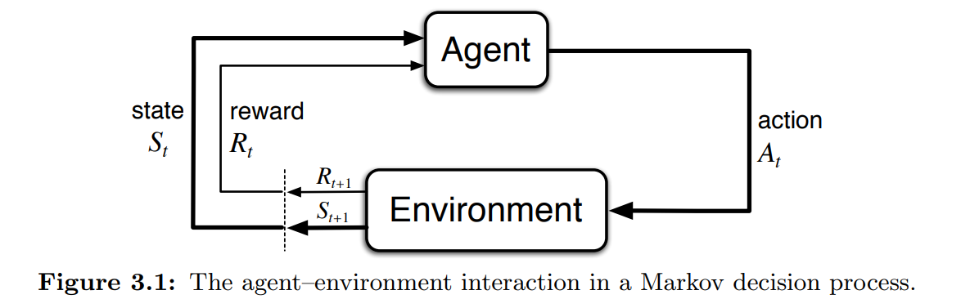
REINFORCEMENT LEARNING
THE AGENT - ENVIRONMENT INTERFACE
S0, A0, R1, S1, A1, R2, S2, A2, R3, …
where S is state, A is action and R is reward
GOAL OF AGENT
Maximize expected cumulative reward
Reinforcement learning is learning what to do—how to map situations to actions—so as to maximize a numerical reward signal. The learner is not told which actions to take, but instead must discover which actions yield the most reward by trying them.
ELEMENTS OF REINFORCEMENT LEARNING
Agentt
Environment
A Policy
A Reward Signal
A Value Function
A Model of Environment

Slide 8
Examples
Training a robot to walk
Give negative award if it falls
Positive rewards if it takes a step
Give negative reward if it takes long time to reach destination
Positive reward if it takes short time to reach destination
Add examples I cannot remember now

Slide 9
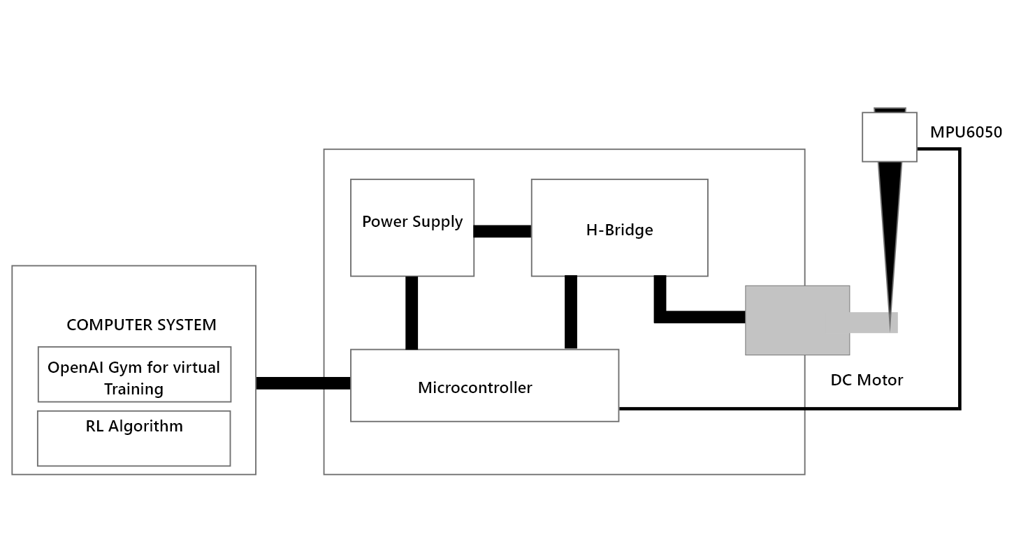
CIRCUIT DIAGRAM

Slide 10
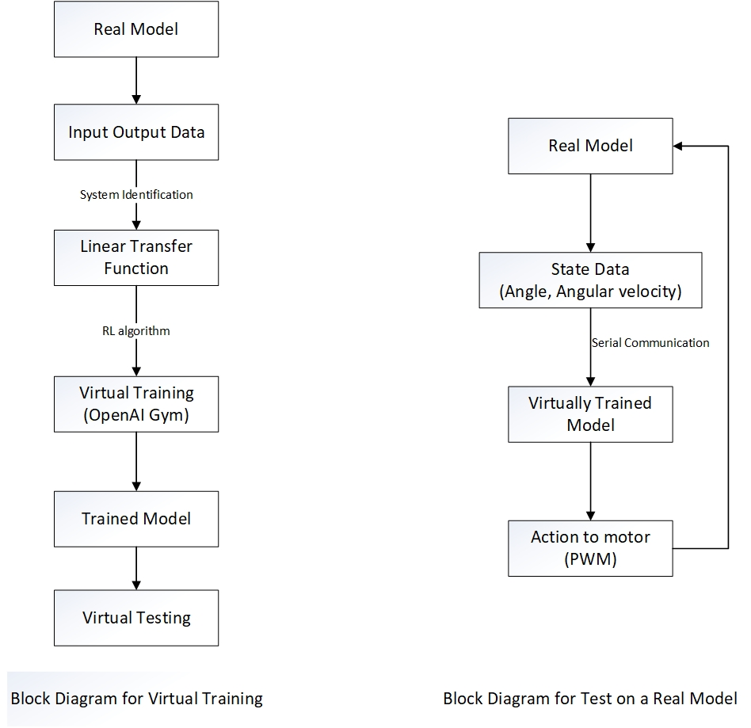
BLOCK DIAGRAM

Slide 11
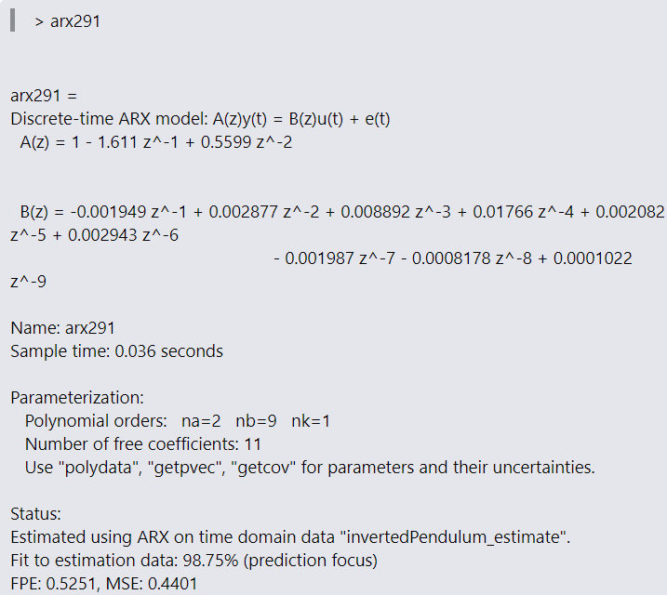
SYSTEM IDENTIFICATION
The sampling time of the system was estimated and set to 36 milliseconds.
PRBS (Pseudorandom Binary Sequence) input was given and corresponding output of the system was observed.
The inputs and outputs are fed to System Identification Toolbox in MatLab where we estimated the Polynomial ARX Model.
The model selection feature of the toolbox is run and we get the order (Na, Nb, Nk) that best describes the system.
The best fit order is selected and the transfer function is generated.

Slide 12
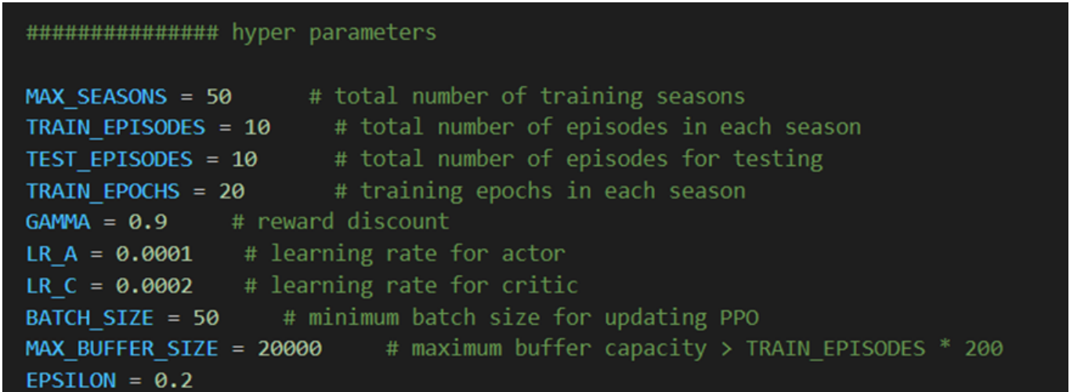
TRAINING/TESTING ON VIRTUAL MODEL
Cost = - (10 * theta^2 + 0.01 * angular velocity^2 + 0.00001 * action^2)

Slide 13
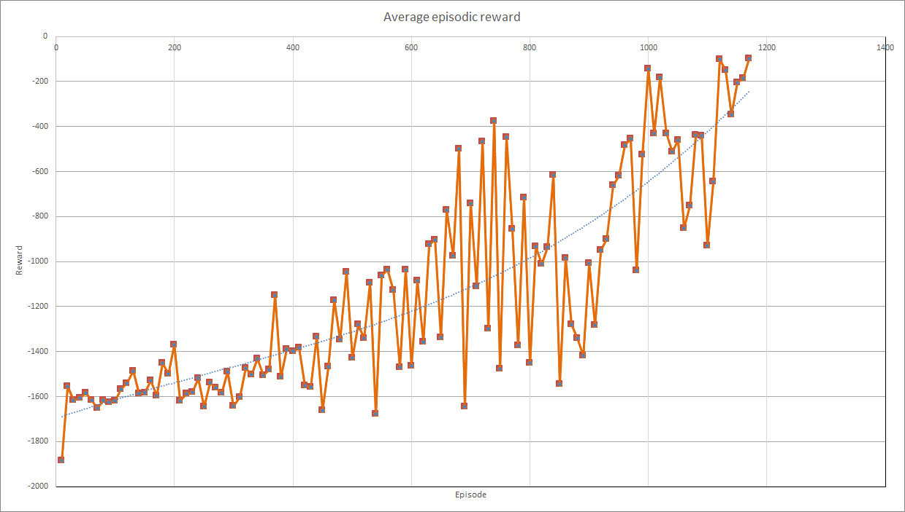

Slide 14
DEPLOYMENT ON REAL MODEL
After successful testing in the virtual environment, we then tested the pre-trained model in real system.
The data was taken from MPU6050 and then transferred to the pre-trained system.
It gives us the PWM input to the motor which is transferred to the Atmega 328P and it is given to the motor via motor driver

Slide 15
SCOPE AND APPLICATIONS
As the complexity of the system increases, the difficulty for optimal control increases. But the reinforcement learning generalises well to the change in complexity and it need not be changed drastically. So, we use reinforcement learning to balance the inverted pendulum. The project can be further improved to balance the system in two dimension which mimics several real life systems.

Slide 16
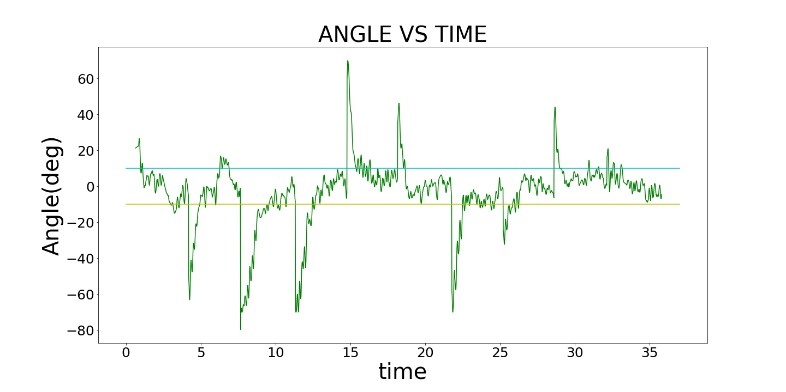
OUTPUT ON VIRTUAL MODEL
The spike represents the start of a new episode.
It can be clearly seen from the graph that the angle settles between the value of ±10°.

Slide 17
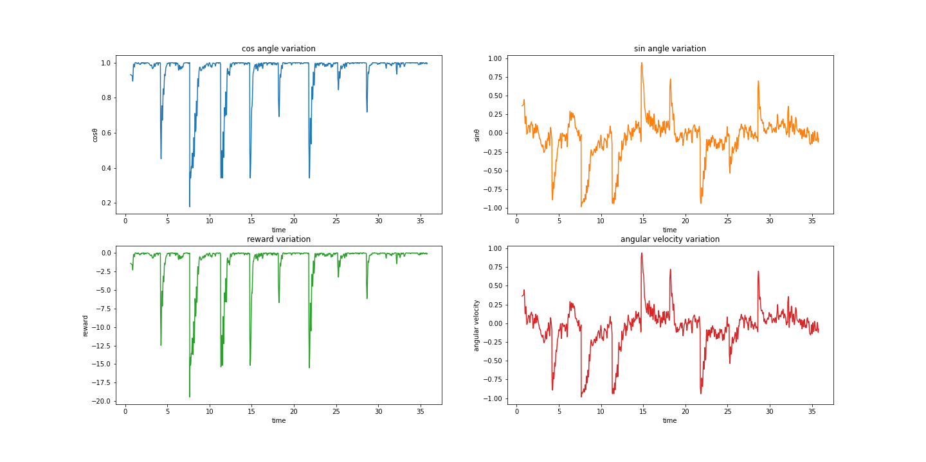
OUTPUT ON VIRTUAL MODEL

Slide 18
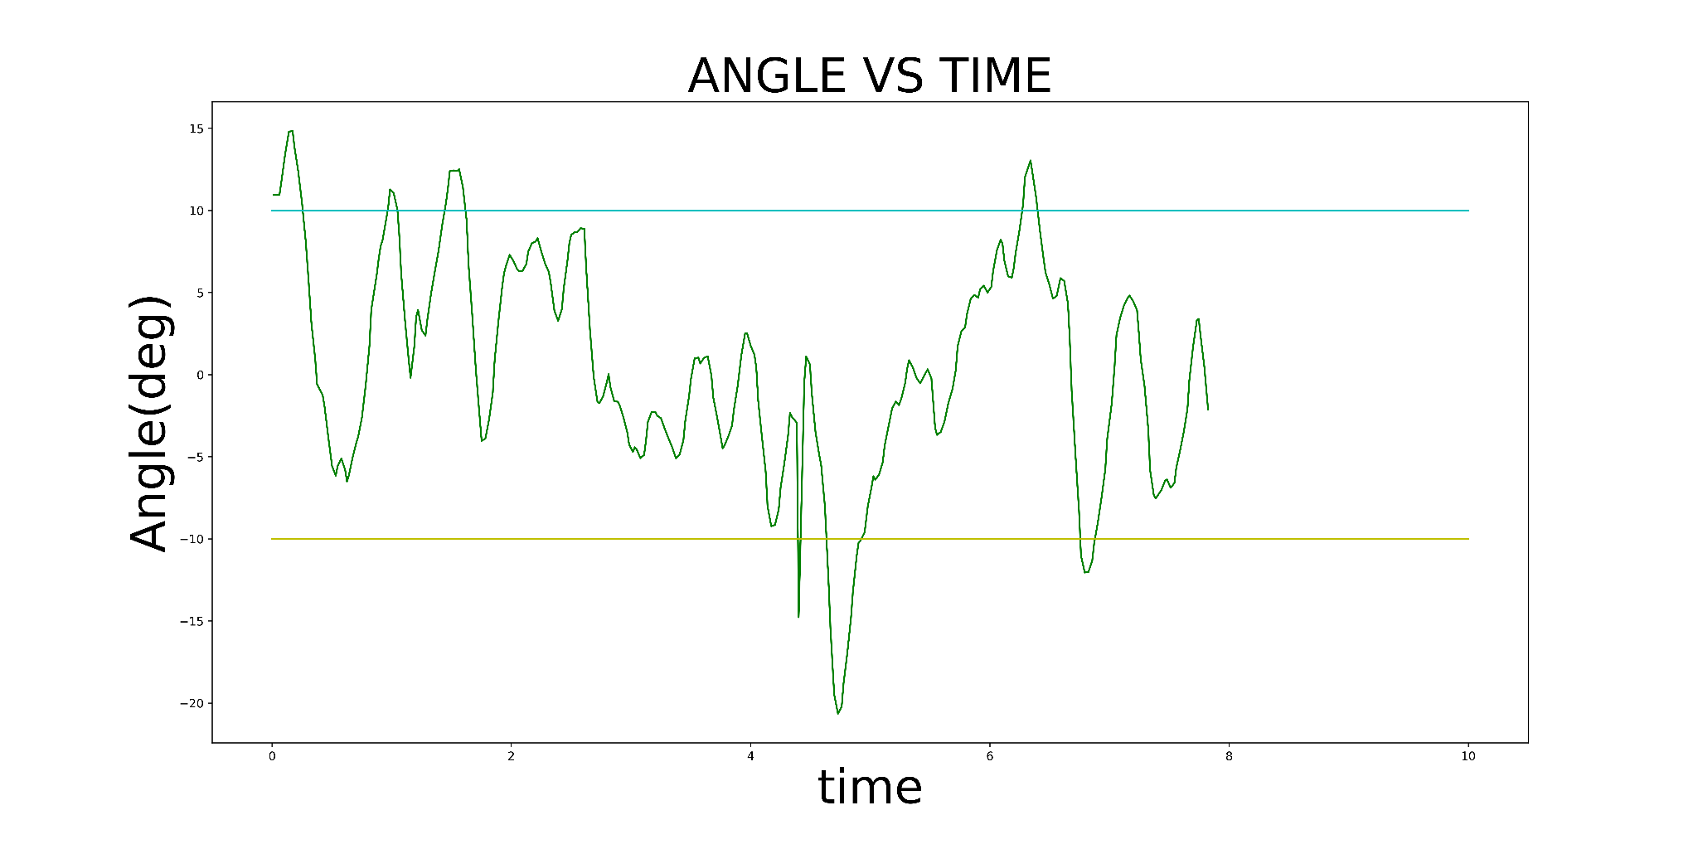
OUTPUT ON REAL MODEL
It can be clearly seen from the graph that the angle settles between the value of ±10°.
The performance is somewhat worse than virtual model. But we can conclude that it generalises well.

Slide 19
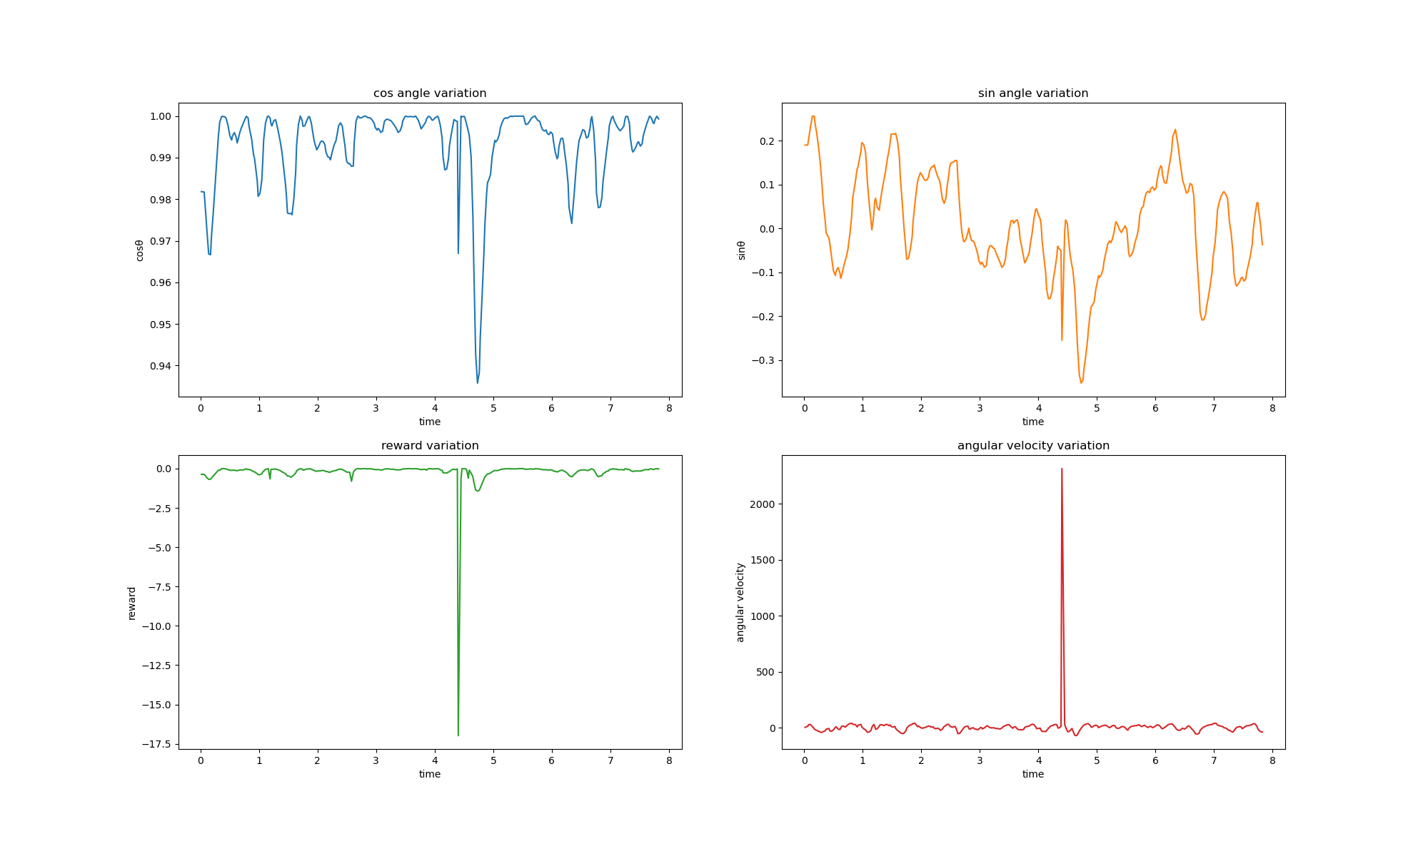
OUTPUT ON REAL MODEL

